Slide 1
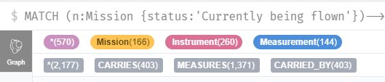

TAMU team – work done so far and next steps
Conducted literature review on
Knowledge representations (knowledge graphs, first-order logic, ontologies, rules, frames, Markov logics)
Methods to auto-generate or complete knowledge graphs (NLP, KG embeddings, Markov logic)
Identified tools to work with knowledge graphs (Neo4j) and Markov Logic (pracmln)
Defined an Earth Observation test case
Mission is to measure a certain parameter over a certain region, time frame with a certain set of attributes (spatial resolution, revisit time, accuracy) - pulled from WMO OSCAR database
Agents are any current Earth observation satellites – pulled from CEOS database
Identified tools to implement a demo (TurtleKit, Orekit, Cesium, VASSAR)
Started prototype implementation
Wrote web scraper for CEOS database
Imported CEOS DB into Neo4j as a KG
Wrote code to parse a KG into the corresponding MLN program
Continued definition of interfaces with tools from other team members.
Next steps:
Continue development of the prototype
Continue integration with other team members

